Slide 1
Countering Online Harms Act 5 Minute Technical Talk
By Ryan J. Skelly – 5/3/2021

Slide 2
Overview (What Topics will we focus on)
What is the Countering Online Harms Act?
What would be protected against?
Why this Legislation Is needed?
Recommendations on How it could be implemented

Slide 3
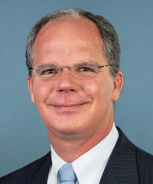

1) What is the Countering Online Harms Act?
U.S. bill passed in the House
Congressman Brett Guthrie(KY-R)
FTC and AI
Focus of the bill to protect U.S Citizens, emphasis on those less tech savvy

Slide 4
2) What would be protected against?
Scams
DeepFake Videos
Illegal Online Content(Opioid Sales, Child Exploitation)
Terrorism
Disinformation Campaigns

Slide 5
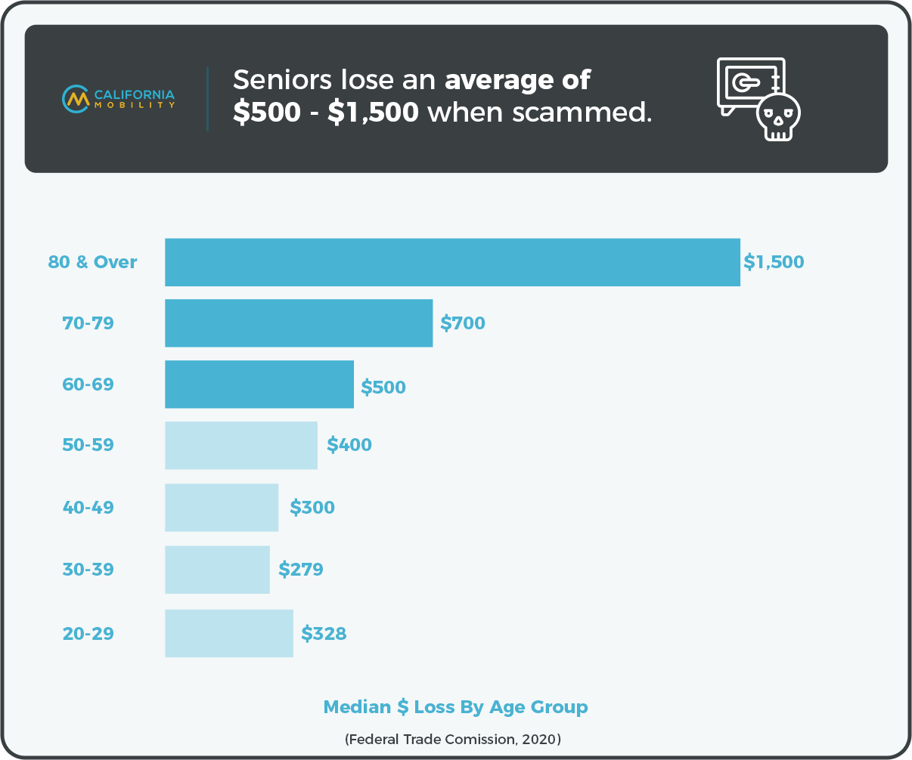
3) Why this Legislation Is needed?
5% of the Elderly, $3 Billion Annually
95% of teens use the internet, 85% are on social media
NH has the highest reported electronic bullying as of 2019(20.1% of Grades 9-12 Students).

Slide 6

4) Recommendations on How it could be Studied/implemented
Target Big Tech
Homeland Threat Analysis
First Amendment Rights
Increased funding/research into the AI field

Slide 7
Thanks!
ANY QUESTIONS?

Slide 8
Sources : (including Pictures)
https://www.verywellmind.com/thmb/2tEVbB5LRmKfR5o7yugtKI1RUpM=/1500x1000/filters:fill(ABEAC3,1)/cyberbullying-and-depression-1066791_final_logo-e3c3fe42e9fd464889fb4227eec96b40.gif
https://aginginplace.org/internet-scams-affecting-elderly/
https://www.cnbc.com/2019/11/23/new-research-pinpoints-how-elderly-people-are-targeted-in-online-scams.html
https://californiamobility.com/senior-citizen-scams-statistics/#:~:text=Seniors%20lose%20an%20average%20of%20%24500%20or%20more%20when%20scammed.&text=The%20median%20individual%20financial%20loss,more%20than%20other%20age%20groups.
https://www.fbi.gov/scams-and-safety/common-scams-and-crimes/elder-fraud
https://www.statista.com/statistics/291078/us-states-with-the-highest-electronic-bullying-rate/
https://guthrie.house.gov/news/documentsingle.aspx?DocumentID=387293
https://www.congress.gov/bill/116th-congress/house-bill/6937?s=1&r=8
https://www.govtrack.us/congress/bills/116/hr6937
https://www.theguardian.com/technology/ng-interactive/2019/jun/22/the-rise-of-the-deepfake-and-the-threat-to-democracy
https://www.bbc.com/news/technology-54444633

